Slide 1

July 2024 Update

Slide 2
Parkapalooza
Free Summer day camp for children ages 6-12
Average of 13 daily campers
Rotating weekly camp themes
June 17-21 Sports Camp at Samuel Felton Park
June 24-28 Fun Being Safe Camp at Oakwood Park
July 8-12 Arts & Crafts Camp at Lakeview South Park
July 15-19 Science & Nature Camp at Falbo Park
July 22-26 Arts & Music Camp at Maple Park

Slide 3
Many leagues are utilizing the parks for tournaments, games and practices.
Summer Sports League
Lorain Hot Stove Baseball-4 teams
Lorain Hot Stove Softball-9 teams
T3 Baseball-14 teams
Legends Baseball-6 teams
Legends Softball-4 teams
Lorain Panthers Baseball-2 teams
Steel City Men’s Softball-6 teams
Steel City Kickball-4 teams
Grind League Basketball
Gurus League Basketball
Northeast Rebels Football
Steel City Youth Football
LCCC Baseball
Lorain City Schools Baseball & Softball
Amherst Chargers Softball

Slide 4
Summer Sports League Our parks have hosted games from April 15-July 1 (12 weeks)
Pipe Yard Stadium: 154 games
Campana Park: 101 games (7 fields)
Oakwood Park: 97 games (4 fields)
Lakeview Park: 83 games (4 fields)
Total: 435 games
Average 36.25 games/week

Slide 5
Campana Park Project
Pipe Yard Stadium: renovated and infield turf installed.
Turf softball field added
7 Fields renovated and soccer fields added
2 new concession/restroom buildings
1 concession/restroom building renovated

Slide 6
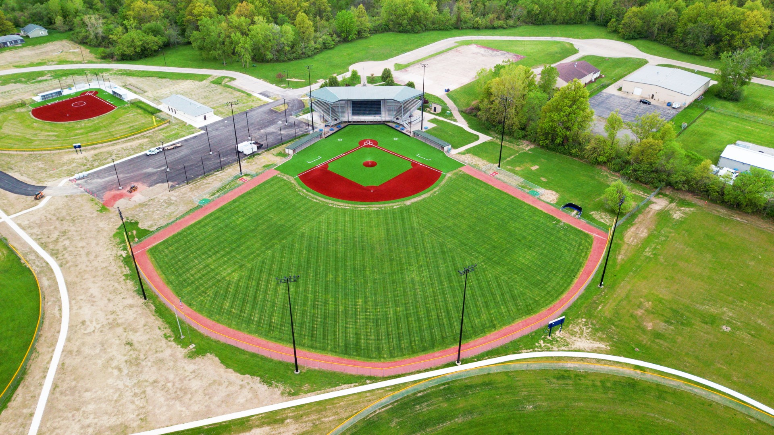
Pipe Yard Stadium
Join us for the official re-dedication of Pipe Yard/Campana Park during the City of Lorain Patriot’s Day Police and Fire Softball game to be held on 9/11/24 at 6 PM. We are excited to showcase the $5.2 million renovation of this facility, a joint effort by the City of Lorain, Lorain City Schools and Ohio Department of Natural Resources.
Highlights of the Event:
Official re-dedication ceremony
Police vs. Fire Softball game
Food and Beverages
Family Friendly Events

Slide 7
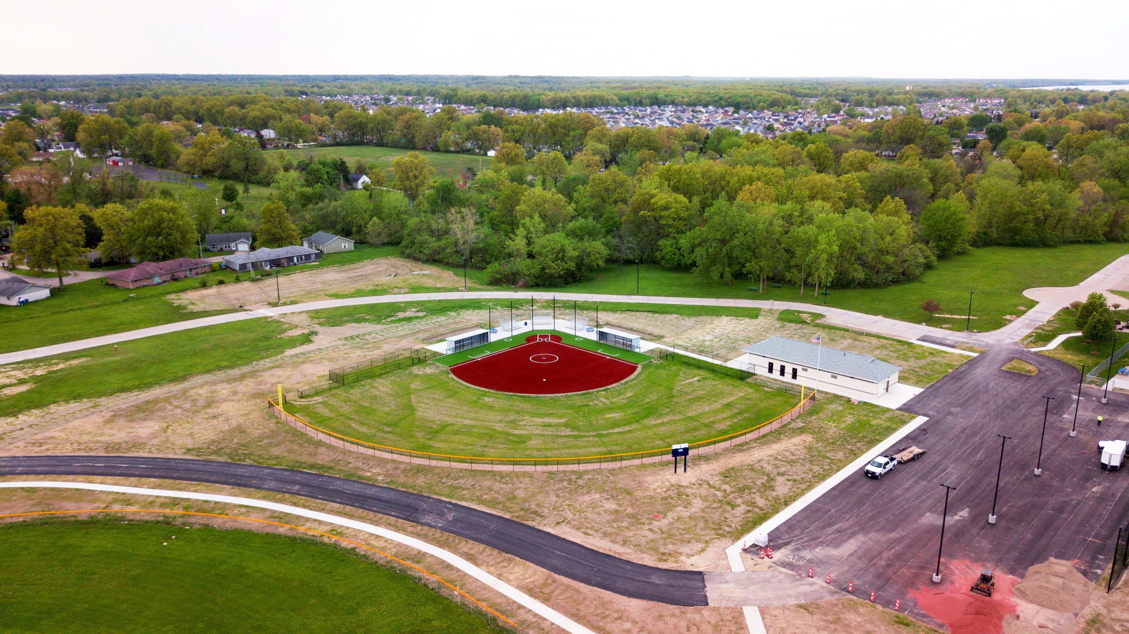
Softball Field

Slide 8
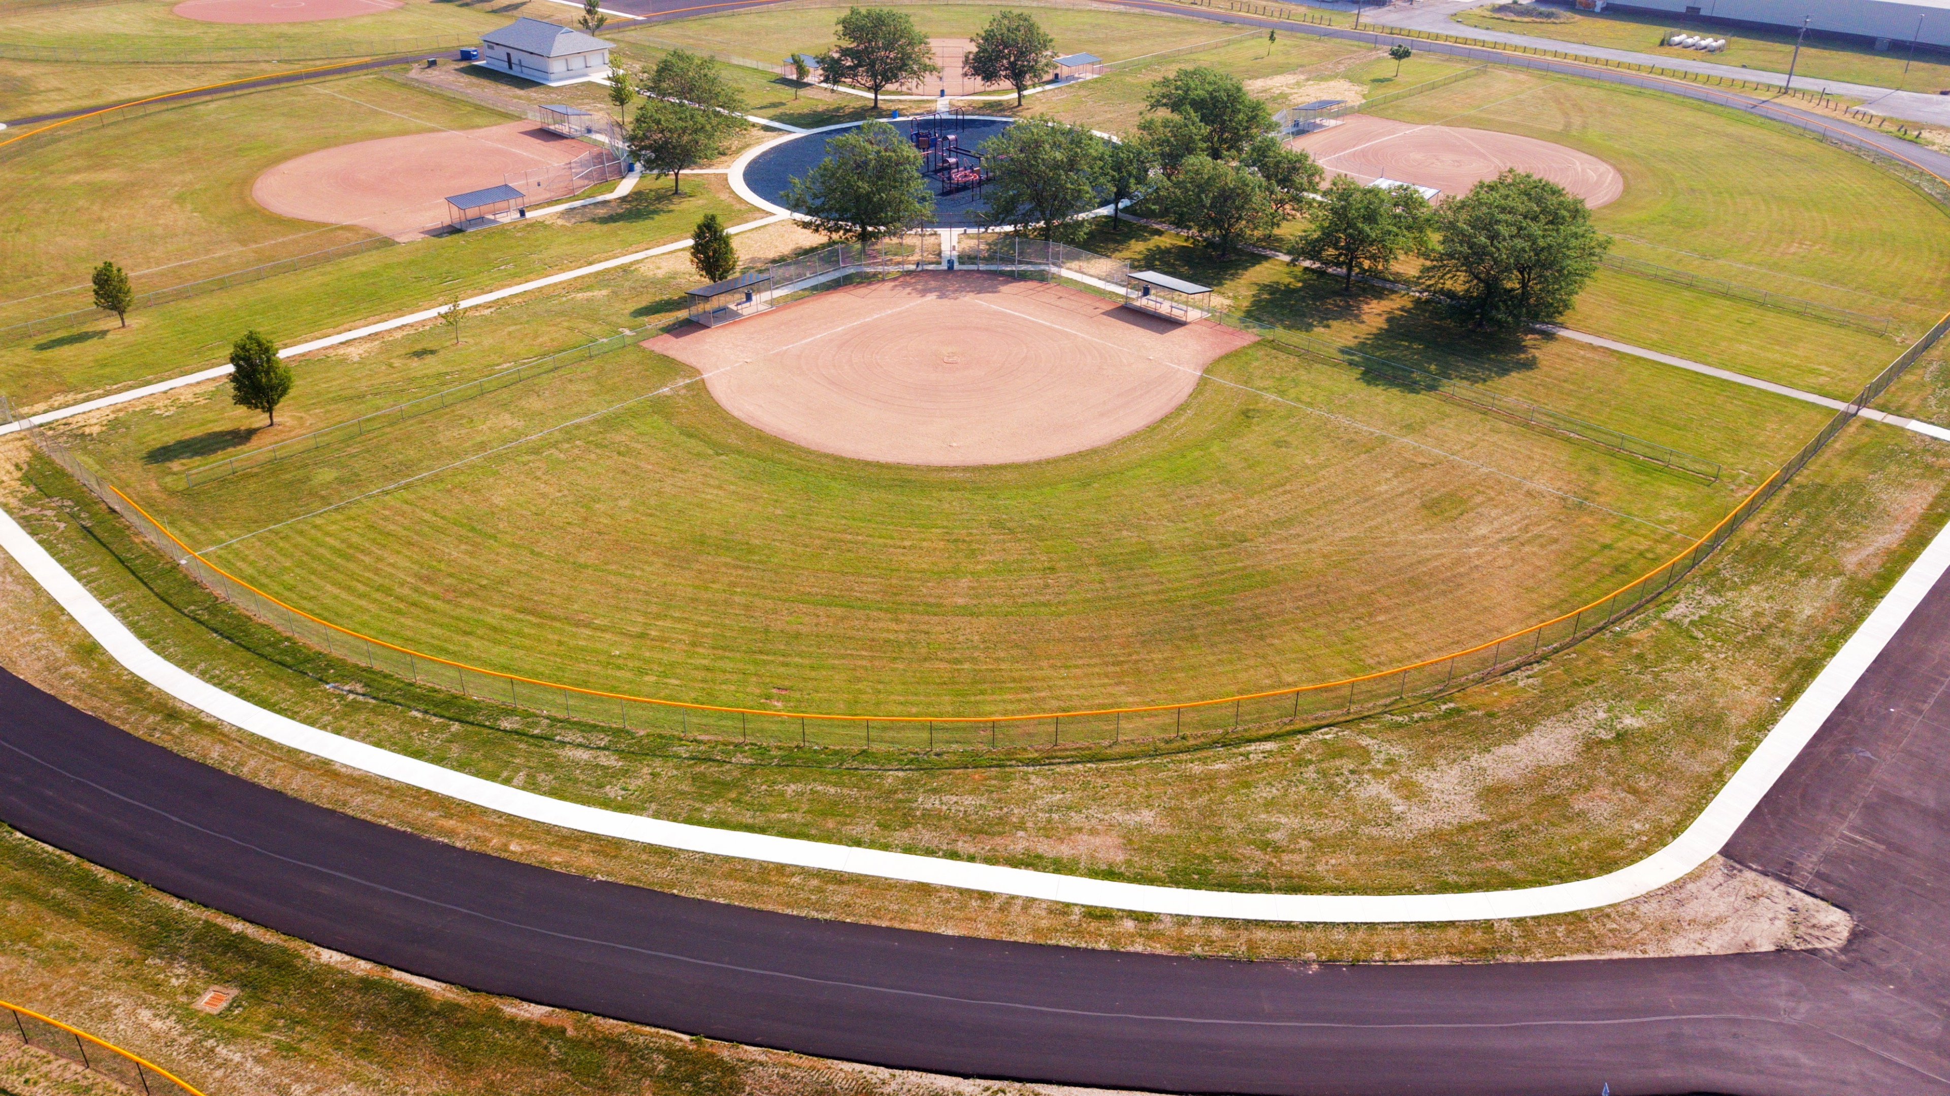
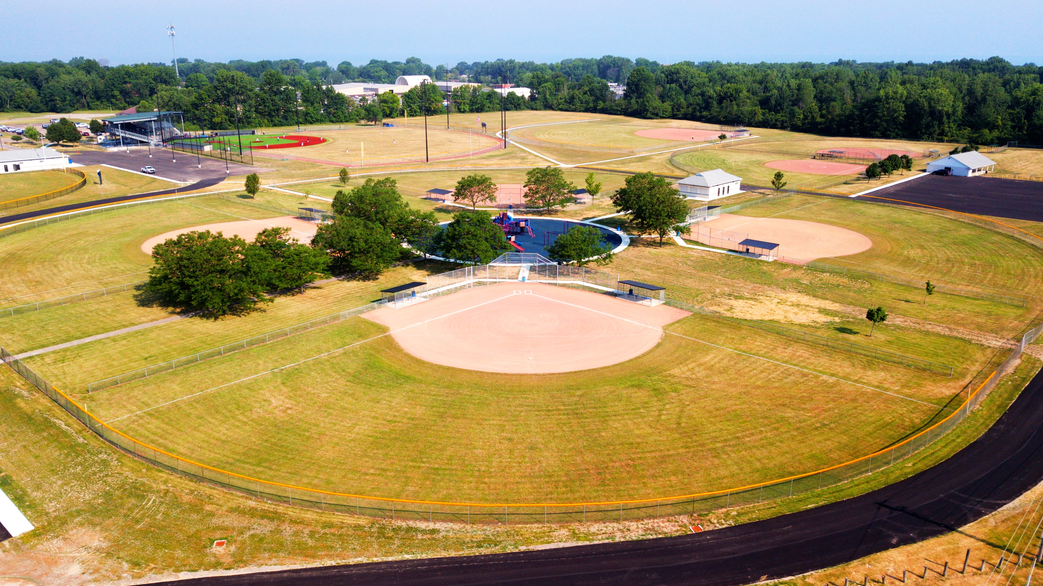
Campana Park

Slide 9
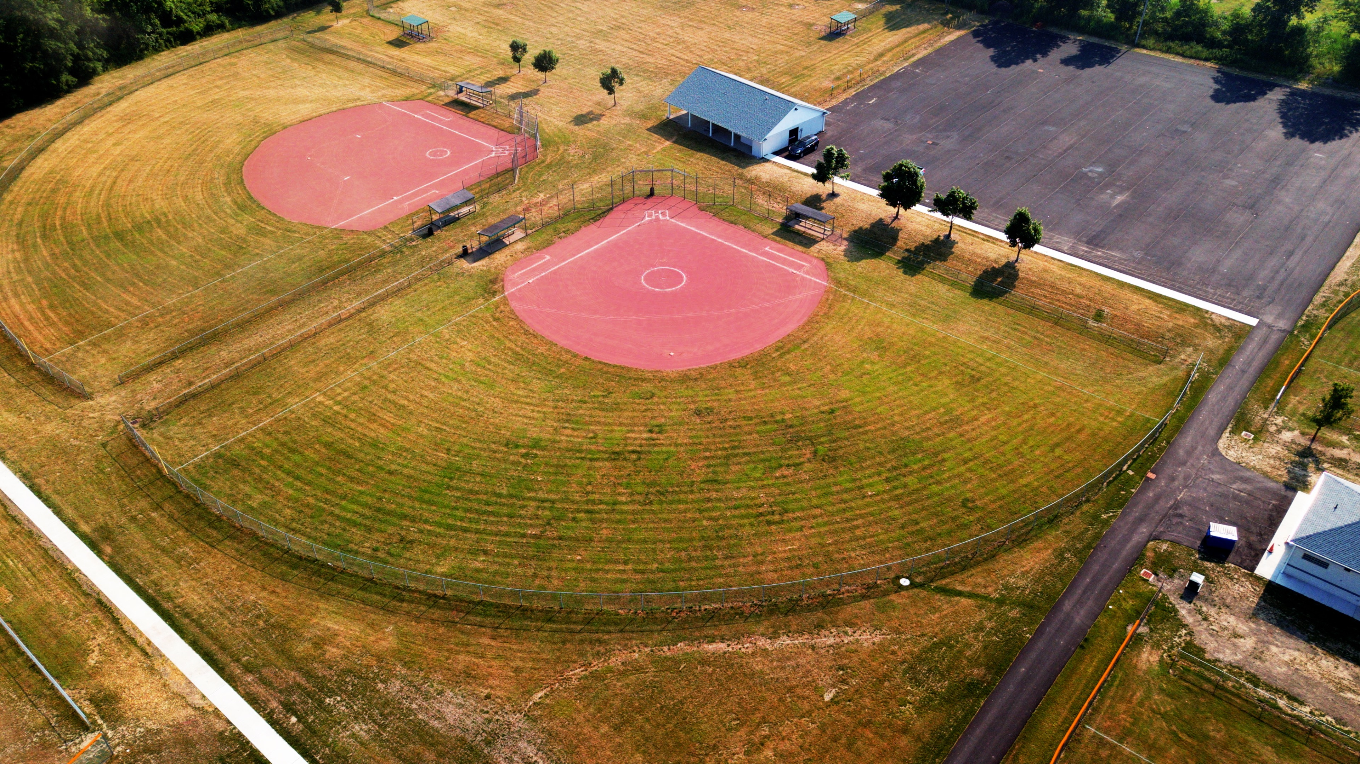
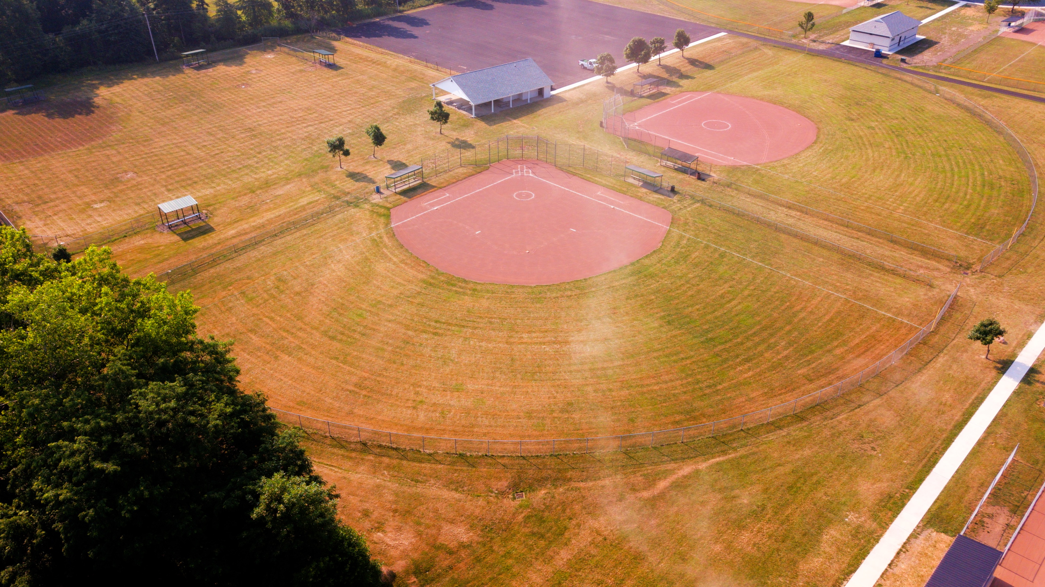

Slide 10
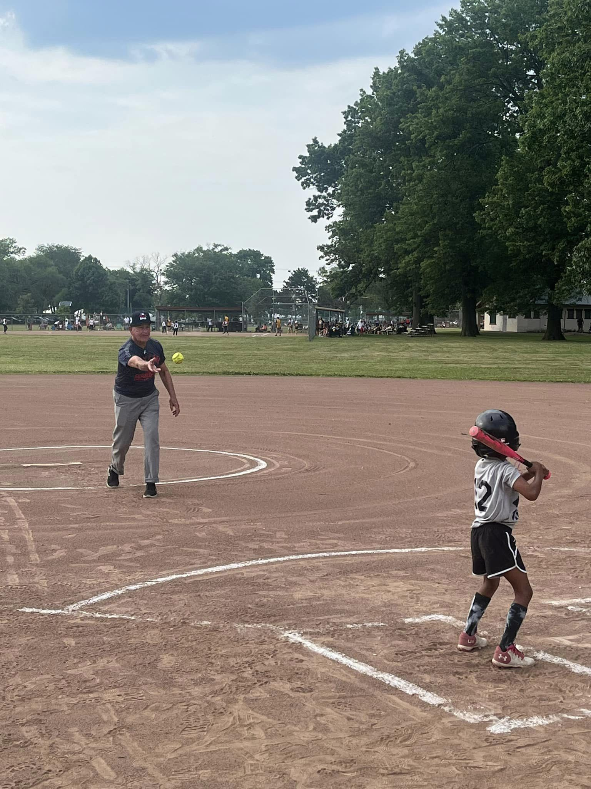
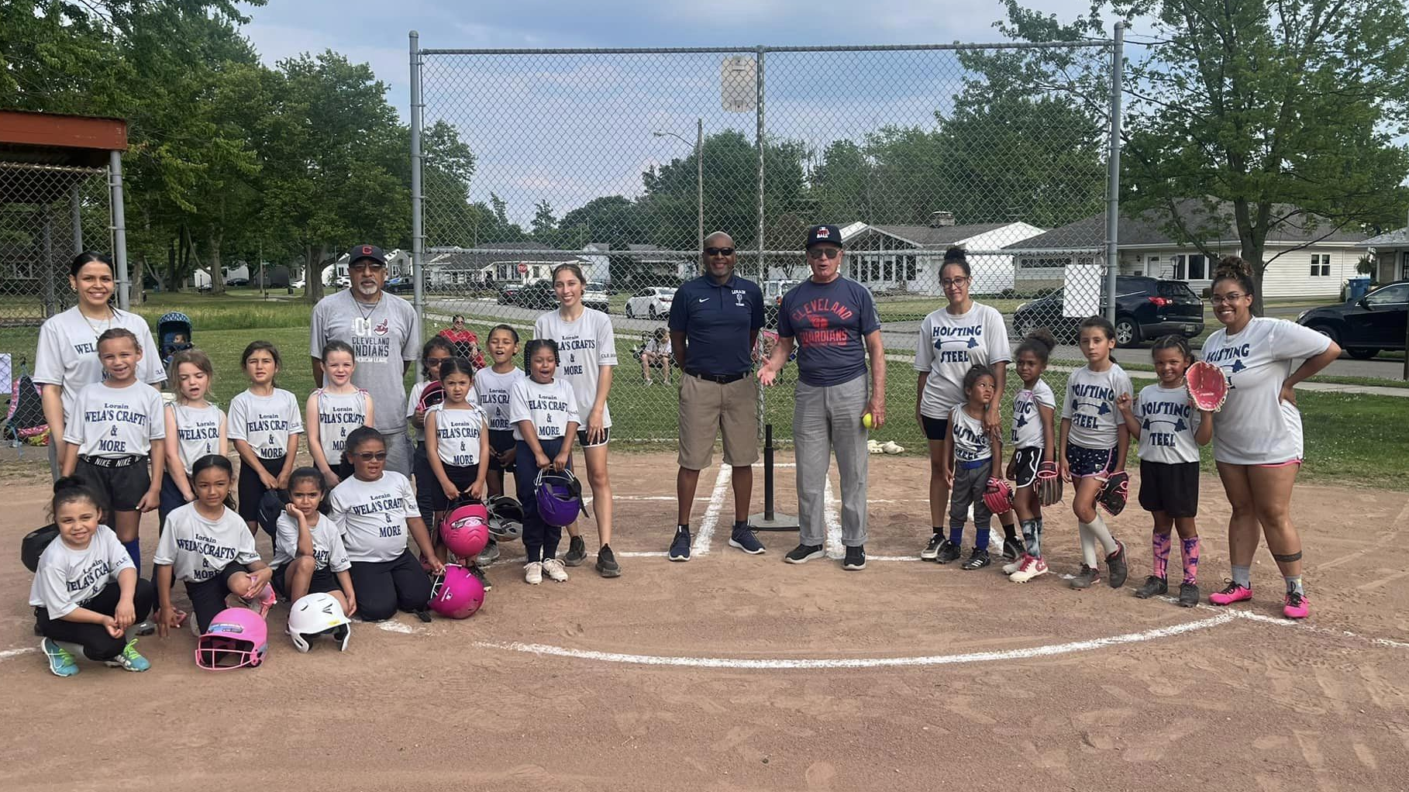
MLB Play Ball Initiative!
The Major League Baseball PLAY BALL initiative is baseball’s collective effort to encourage young people and communities to engage in baseball and softball related activities.
Mayor Bradley threw out the first pitch at a 6U Lorain Hot Stove softball game!

Slide 11
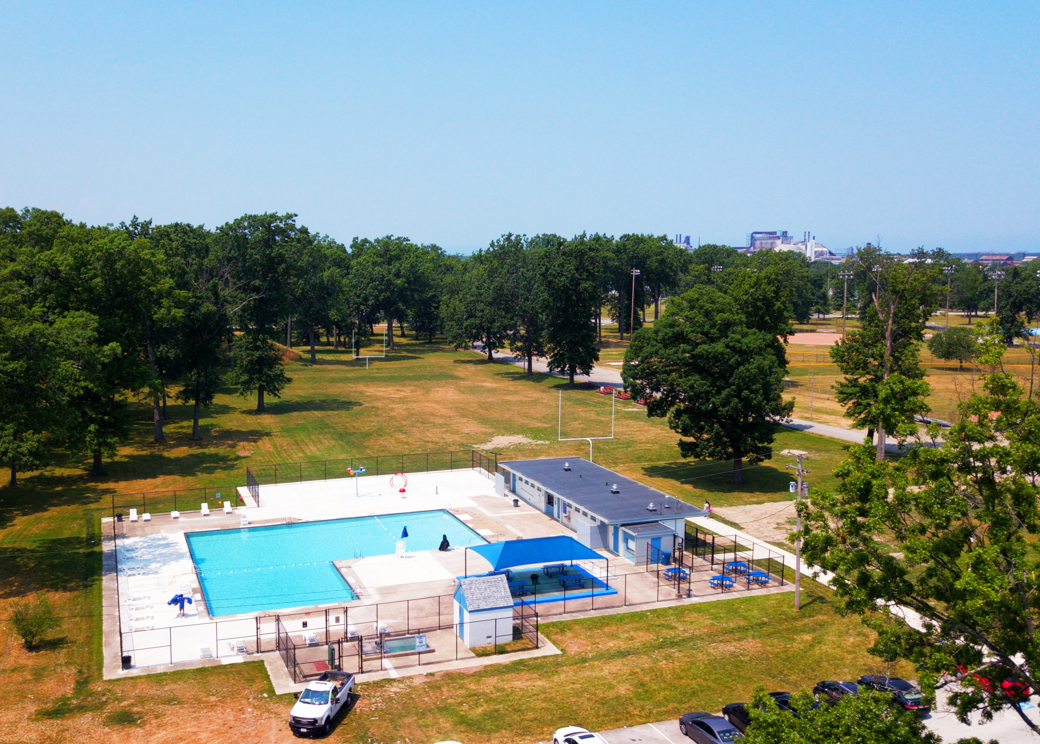
Oakwood Park Pool Re-Opening
The pool has not been opened since 2016
Bath House
Splash Pad
Shaded pavilion
Lifeguard chairs
Lounge chairs
Picnic tables
Oakwood Park pool has an average attendance of 100 daily swimmers!
We have sold several pool passes.
Thanks to the generous donations from the Friend’s of South Lorain and David Arocho we were able to provide 30 family and 8 individual passes. Passes still available upon request through July 22, 2024.

Slide 12
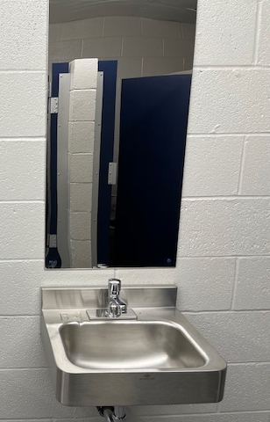
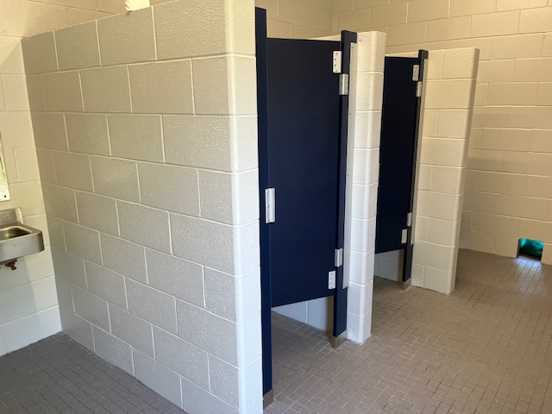
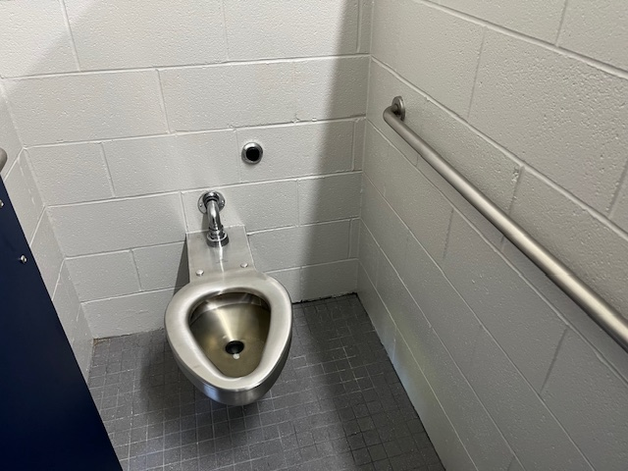
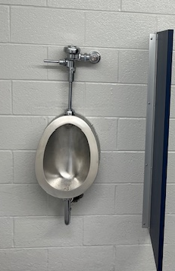
New Restrooms!
Remodeled restrooms at Central Park and Oakwood ParkPk

Slide 13
Lakeview South Play Area
The new early childhood playground, specifically designed for children ages 5 and under, is the first of its kind in the City of Lorain. It was funded by a grant from the Lorain County Children and Family First Council. Join us for the grand opening on September 28th from 12 PM-4 PM, which will feature a carnival theme.

Slide 14
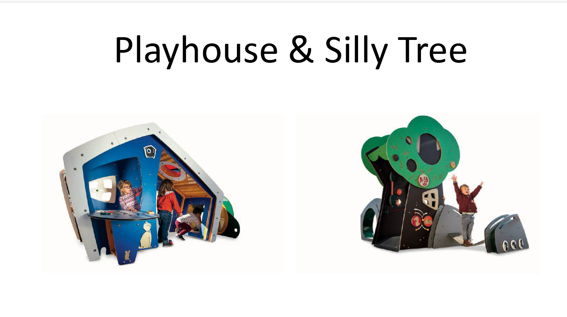

Slide 15

Lorain Skate Park
SKATEPARK TIMELINE
March 2021: David Mihajlovich, age 13, drafts a letter to the mayor regarding Lorain’s need for a skate/BMX park
September 2021: Shred with Ed & Dominic Jacobs get involved in the fund-raising efforts
October 2021: First Skatepark Community Forum held at the Palace
Spring 2023: City advertises for Request or Proposals for designs
December 2023: Skatepark Community Forum presented by Spohn Ranch & the City of Lorain
February 2024: Site surveys are done at proposed site for the park (Longfellow)
March 2024: Spohn Ranch and City of Lorain design focus group begin bi-weekly meetings
COMING SOON: Community Forum with Spohn Ranch displaying design options
CITY of LORAIN’S INVOLVEMENT
*overseeing design and development
*contributing funding
*providing space for the skatepark and amenities

Slide 16
Maintenance Plans
Maintenance and upkeep of all 50+ city parks
Picnic table and bench repairs
Mulch and continue to clean playgrounds
Continue to stay on top of cutting grass
Cleaning up the basketball courts
Trim and maintain trees
Any other type of repairs needed

Slide 17
Upcoming Projects
New concrete dugouts at Oakwood fields 1 & 4
Squirrel’s Nest Disc Golf course signage
Restroom renovations at Cityview Park, General Johnnie Wilson Park and Lakeview Park
Our new Parks & Recreation coordinator, Mindy Stoyka, who started on April 29, 2024, is collaborating with Lorain City Schools on sports clinics. She is also working with Serenity Pickleball Club to coordinate a pickleball tournament and is establishing recreation programs for the upcoming year.

Slide 18
Collaborating Partners
Art in the Park
FireFish
Lorain Historical Society
Little Lighthouse Learning Center
YMCA
Lorain County and Family First Council
Lorain Public Library
Fit4youth
United Way
El Centro
Horizon

